Slide 1
Pandas

Slide 2
What is Pandas?
Pandas is a Python library used for working with data sets.
It has functions for analyzing, cleaning, exploring, and manipulating data.
The name "Pandas" has a reference to both "Panel Data", and "Python Data Analysis" and was created by Wes McKinney in 2008.

Slide 3
Why Use Pandas?
Pandas allows us to analyze big data and make conclusions based on statistical theories.
Pandas can clean messy data sets, and make them readable and relevant.
Relevant data is very important in data science.

Slide 4
What Can Pandas Do?
Pandas give you answers about the data. Like:
Is there a correlation between two or more columns?
What is the average value?
Max value?
Min value?
Pandas are also able to delete rows that are not relevant or contain wrong values, like empty or NULL values. This is called cleaning the data.

Slide 5
Installation of Pandas
If you have Python and PIP already installed on a system, then installation of Pandas is very easy.
Install it using this command:
C:\Users\Your Name>pip install pandas
C:\Users\Your Name>pip install pandas

Slide 6
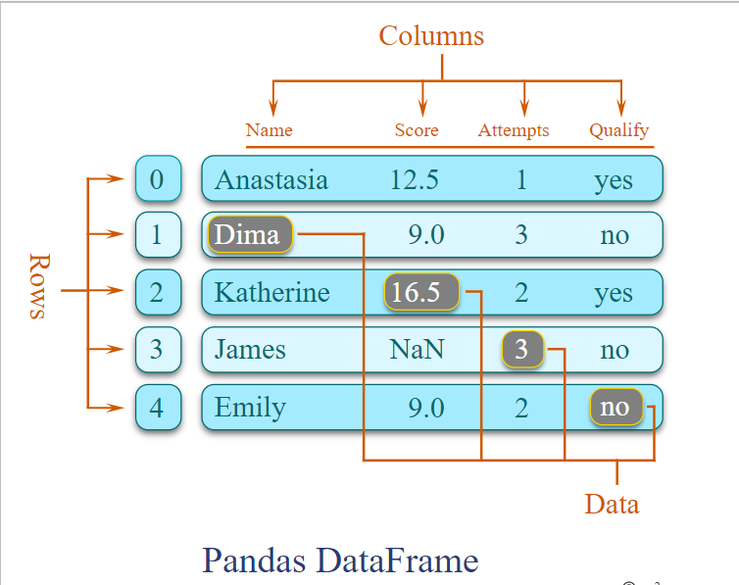

Slide 7
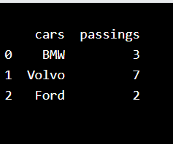
Example
import pandas mydataset = { 'cars': ["BMW", "Volvo", "Ford"], 'passings': [3, 7, 2] } myvar = pandas.DataFrame(mydataset) print(myvar)

Slide 8
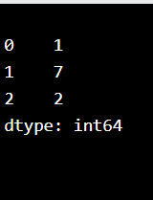
Pandas Series
A Pandas Series is like a column in a table.
It is a one-dimensional array holding data of any type.
Example
Create a simple Pandas Series from a list:
import pandas as pd a = [1, 7, 2] myvar = pd.Series(a) print(myvar)

Slide 9
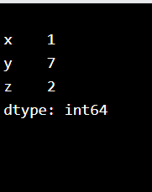
Create Labels
With the index argument, you can name your own labels.
Example
Create your own labels:
import pandas as pd a = [1, 7, 2] myvar = pd.Series(a, index = ["x", "y", "z"]) print(myvar)

Slide 10
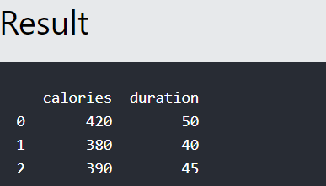
Pandas DataFrames
A Pandas DataFrame is a 2-dimensional data structure, like a 2-dimensional array, or a table with rows and columns.
Example
Create a simple Pandas DataFrame:
import pandas as pd data = { "calories": [420, 380, 390], "duration": [50, 40, 45] } #load data into a DataFrame object: df = pd.DataFrame(data) print(df)

Slide 11
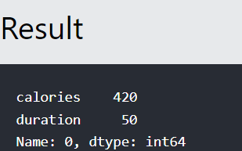
Locate Row
As you can see from the result above, the DataFrame is like a table with rows and columns.
Pandas use the loc attribute to return one or more specified row(s)
Example
#Return row 0:
#refer to the row index:
print(df.loc[0])

Slide 12
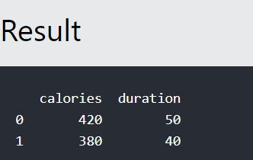
Example
Return row 0 and 1:
#use a list of indexes: print(df.loc[[0, 1]])

Slide 13
Pandas Read CSV
Read CSV Files
A simple way to store big data sets is to use CSV files (comma separated files).
CSV files contains plain text and is a well know format that can be read by everyone including Pandas.
In our examples we will be using a CSV file called 'data.csv'.

Slide 14
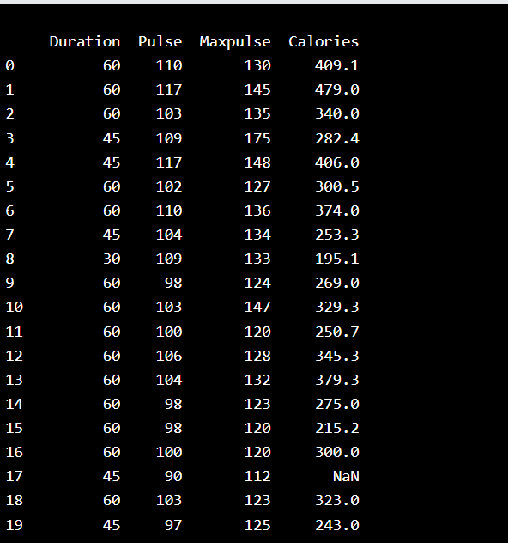
Example
Load the CSV into a DataFrame:
import pandas as pd df = pd.read_csv('data.csv') print(df.to_string())

Slide 15
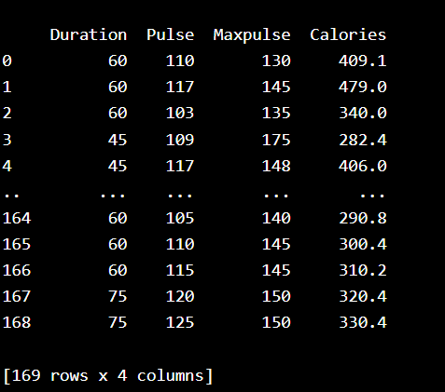
Example
If you have a large DataFrame with many rows, Pandas will only return the first 5 rows, and the last 5 rows:
Print the DataFrame without the to_string() method:
import pandas as pd
df = pd.read_csv('data.csv')
print(df)

Slide 16
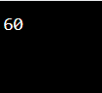
max_rows
he number of rows returned is defined in Pandas option settings.
You can check your system's maximum rows with the pd.options.display.max_rows statement.
Example
Check the number of maximum returned rows:
import pandas as pd print(pd.options.display.max_rows)

Slide 17
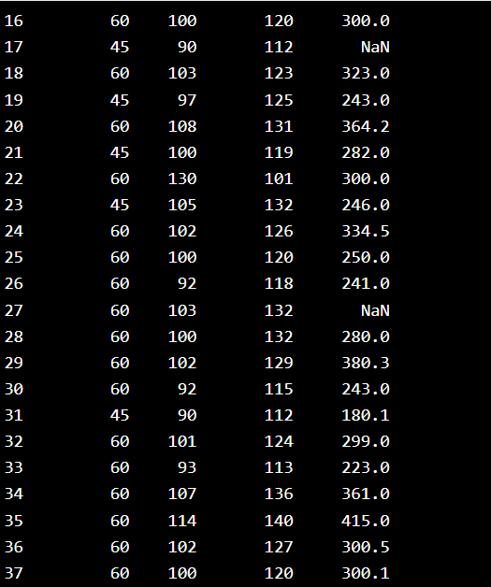
Example
Increase the maximum number of rows to display the entire DataFrame:
import pandas as pd pd.options.display.max_rows = 9999 df = pd.read_csv('data.csv') print(df)

Slide 18
Exercise
Write a Pandas program to get the first 3 rows of a given DataFrame. Sample DataFrame: exam_data = {'name': ['Anastasia', 'Dima', 'Katherine', 'James', 'Emily', 'Michael', 'Matthew', 'Laura', 'Kevin', 'Jonas'], 'score': [12.5, 9, 16.5, np.nan, 9, 20, 14.5, np.nan, 8, 19], 'attempts': [1, 3, 2, 3, 2, 3, 1, 1, 2, 1], 'qualify': ['yes', 'no', 'yes', 'no', 'no', 'yes', 'yes', 'no', 'no', 'yes']} labels = ['a', 'b', 'c', 'd', 'e', 'f', 'g', 'h', 'i', 'j']

Slide 19
print("\n",df[['name', 'score']])
print("Number of attempts in the examination is greater than 2:")
print(df[df['attempts'] > 2])

Slide 20
Pandas - Cleaning Data
Data cleaning means fixing bad data in your data set.
Bad data could be:
Empty cells
Data in wrong format
Wrong data
Duplicates

Slide 21
Pandas - Cleaning Empty Cells
Empty Cells
Empty cells can potentially give you a wrong result when you analyze data.
Remove Rows
One way to deal with empty cells is to remove rows that contain empty cells.

Slide 22
Example
Return a new Data Frame with no empty cells:
import pandas as pd df = pd.read_csv('data.csv') new_df = df.dropna() print(new_df.to_string())

Slide 23
If you want to change the original DataFrame, use the
inplace = True
Example
Remove all rows with NULL values:
import pandas as pd df = pd.read_csv('data.csv') df.dropna(inplace = True) print(df.to_string())

Slide 24
Replace Empty Values
Another way of dealing with empty cells is to insert a new value instead.
This way you do not have to delete entire rows just because of some empty cells.
The fillna() method allows us to replace empty cells with a value:

Slide 25
Example
Replace NULL values with the number 130:
import pandas as pd df = pd.read_csv('data.csv') df.fillna(130, inplace = True)

Slide 26
Replace Only For Specified Columns
The example above replaces all empty cells in the whole Data Frame.
To only replace empty values for one column, specify the column name for the DataFrame:
Example
Replace NULL values in the "Calories" columns with the number 130:
import pandas as pd df = pd.read_csv('data.csv') df["Calories"].fillna(130, inplace = True)

Slide 27
Replace Using Mean, Median, or Mode
A common way to replace empty cells, is to calculate the mean, median or mode value of the column.
Pandas uses the mean() median() and mode() methods to calculate the respective values for a specified column:

Slide 28
Example
Calculate the MEAN, and replace any empty values with it:
import pandas as pd df = pd.read_csv('data.csv') x = df["Calories"].mean() df["Calories"].fillna(x, inplace = True)

Slide 29
Example
Calculate the MEDIAN, and replace any empty values with it:
import pandas as pd df = pd.read_csv('data.csv') x = df["Calories"].median() df["Calories"].fillna(x, inplace = True)

Slide 30
Example
Calculate the MODE, and replace any empty values with it:
import pandas as pd df = pd.read_csv('data.csv') x = df["Calories"].mode()[0] df["Calories"].fillna(x, inplace = True)

Slide 31
Pandas - Cleaning Data of Wrong Format
Data of Wrong Format
Cells with data of wrong format can make it difficult, or even impossible, to analyze data.
To fix it, you have two options: remove the rows, or convert all cells in the columns into the same format.

Slide 32
Example
Convert to date:
import pandas as pd df = pd.read_csv('data.csv') df['Date'] = pd.to_datetime(df['Date']) print(df.to_string())

Slide 33
Removing Rows
The result from the converting in the example above gave us a NaT value, which can be handled as a NULL value, and we can remove the row by using the dropna() method.
Example
Remove rows with a NULL value in the "Date" column:
df.dropna(subset=['Date'], inplace = True)

Slide 34
Pandas - Fixing Wrong Data
Wrong Data
"Wrong data" does not have to be "empty cells" or "wrong format", it can just be wrong, like if someone registered "199" instead of "1.99".
Sometimes you can spot wrong data by looking at the data set, because you have an expectation of what it should be.

Slide 35
Replacing Values
One way to fix wrong value
Example
Set "Duration" = 45 in row 7:
df.loc[7, 'Duration'] = 45

Slide 36
Example
Loop through all values in the "Duration" column.
If the value is higher than 120, set it to 120:
for x in df.index: if df.loc[x, "Duration"] > 120: df.loc[x, "Duration"] = 120

Slide 37
Removing Rows
Another way of handling wrong data is to remove the rows that contains wrong data.
Example
Delete rows where "Duration" is higher than 120:
for x in df.index: if df.loc[x, "Duration"] > 120: df.drop(x, inplace = True)

Slide 38
Pandas - Removing Duplicates
To discover duplicates, we can use the duplicated() method.
The duplicated() method returns a Boolean values for each row:
Example
Returns True for every row that is a duplicate, othwerwise False:
print(df.duplicated())

Slide 39
Removing Duplicates
To remove duplicates, use the drop_duplicates() method.
Example
Remove all duplicates:
df.drop_duplicates(inplace = True)

Slide 40
Pandas - Data Correlations
Finding Relationships
A great aspect of the Pandas module is the corr() method.
The corr() method calculates the relationship between each column in your data set.
The examples in this page uses a CSV file called: 'data.csv'.

Slide 41
Example
Show the relationship between the columns:
df.corr()

Slide 42
Pandas - Analyzing DataFrames
Viewing the Data
One of the most used method for getting a quick overview of the DataFrame, is the head() method.
The head() method returns the headers and a specified number of rows, starting from the top.

Slide 43
Example
Get a quick overview by printing the first 10 rows of the DataFrame:
import pandas as pd df = pd.read_csv('data.csv') print(df.head(10))

Slide 44
Example
Print the first 5 rows of the DataFrame:
import pandas as pd df = pd.read_csv('data.csv') print(df.head())

Slide 45
Example
Print the last 5 rows of the DataFrame:
print(df.tail())

Slide 46
Pandas - Plotting
Plotting
Pandas uses the plot() method to create diagrams.
We can use Pyplot, a submodule of the Matplotlib library to visualize the diagram on the screen.

Slide 47
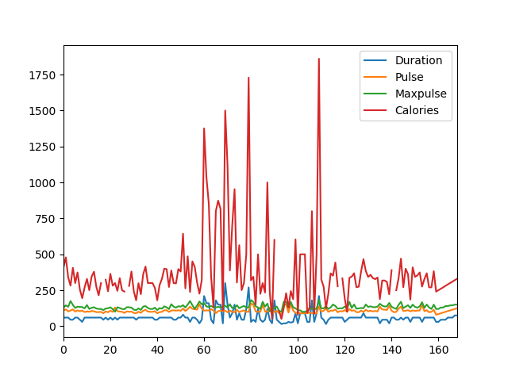
#Three lines to make our compiler able to draw:
import sys
import matplotlib
matplotlib.use('Agg')
import pandas as pd
import matplotlib.pyplot as plt
df = pd.read_csv('data.csv')
df.plot()
plt.show()
#Two lines to make our compiler able to draw:
plt.savefig(sys.stdout.buffer)
sys.stdout.flush()

Slide 48
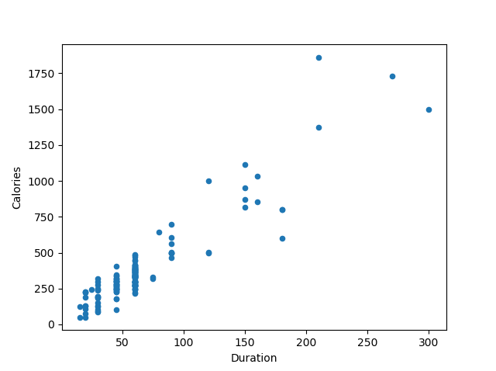
#Three lines to make our compiler able to draw:
import sys
import matplotlib
matplotlib.use('Agg')
import pandas as pd
import matplotlib.pyplot as plt
df = pd.read_csv('data.csv')
df.plot(kind = 'scatter', x = 'Duration', y = 'Calories')
plt.show()
#Two lines to make our compiler able to draw:
plt.savefig(sys.stdout.buffer)
sys.stdout.flush()

Slide 49
Thanks

